Slide 1
Heimdall: Mobile GPU Coordination Platform for Augmented Reality Applications
Juheon Yi, Youngki Lee
Seoul National University
ACM MobiCom 2020

Slide 2
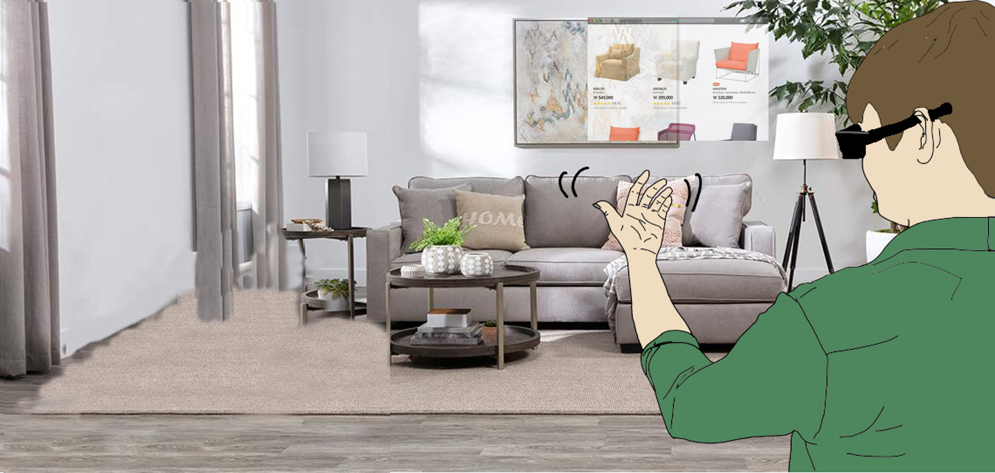
Example App: Immersive Shopping

Slide 3
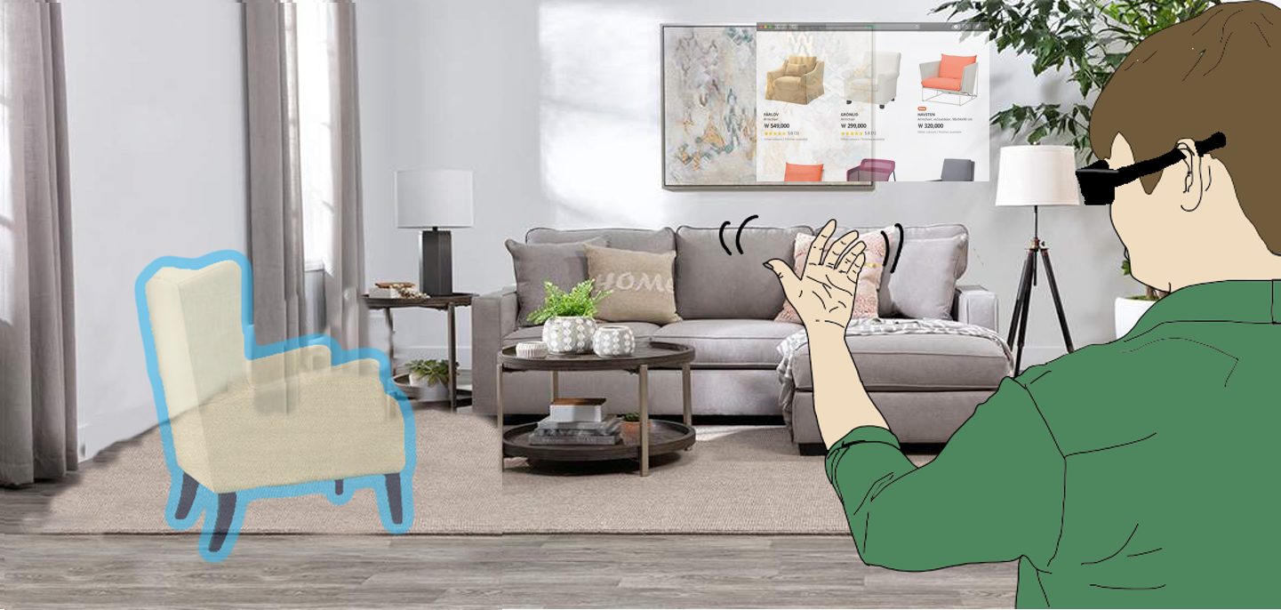
Example App: Immersive Shopping

Slide 4
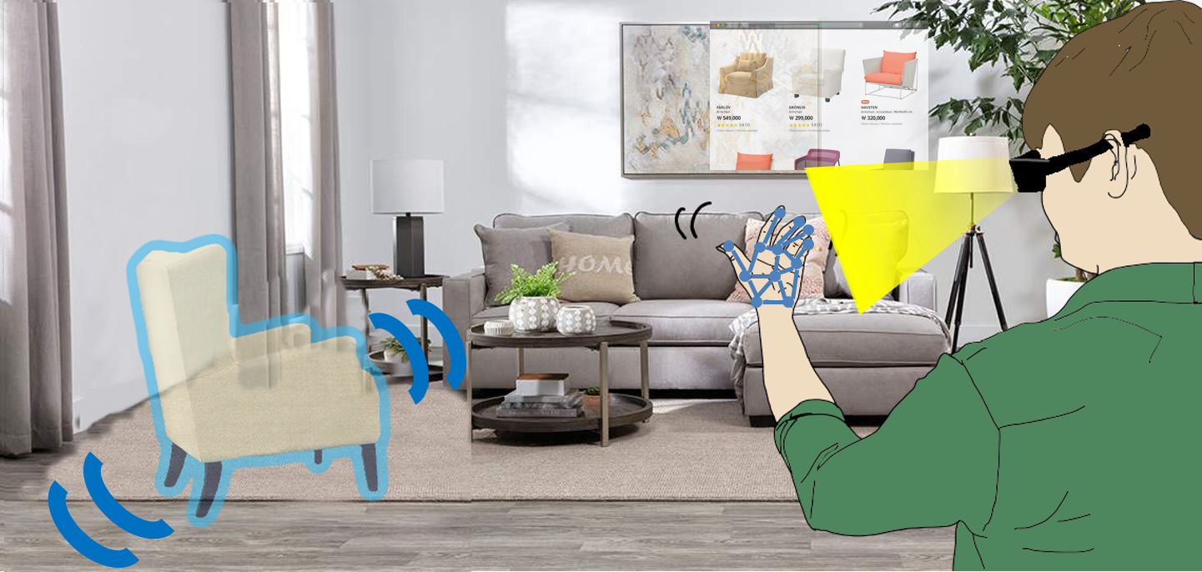
Example App: Immersive Shopping

Slide 5
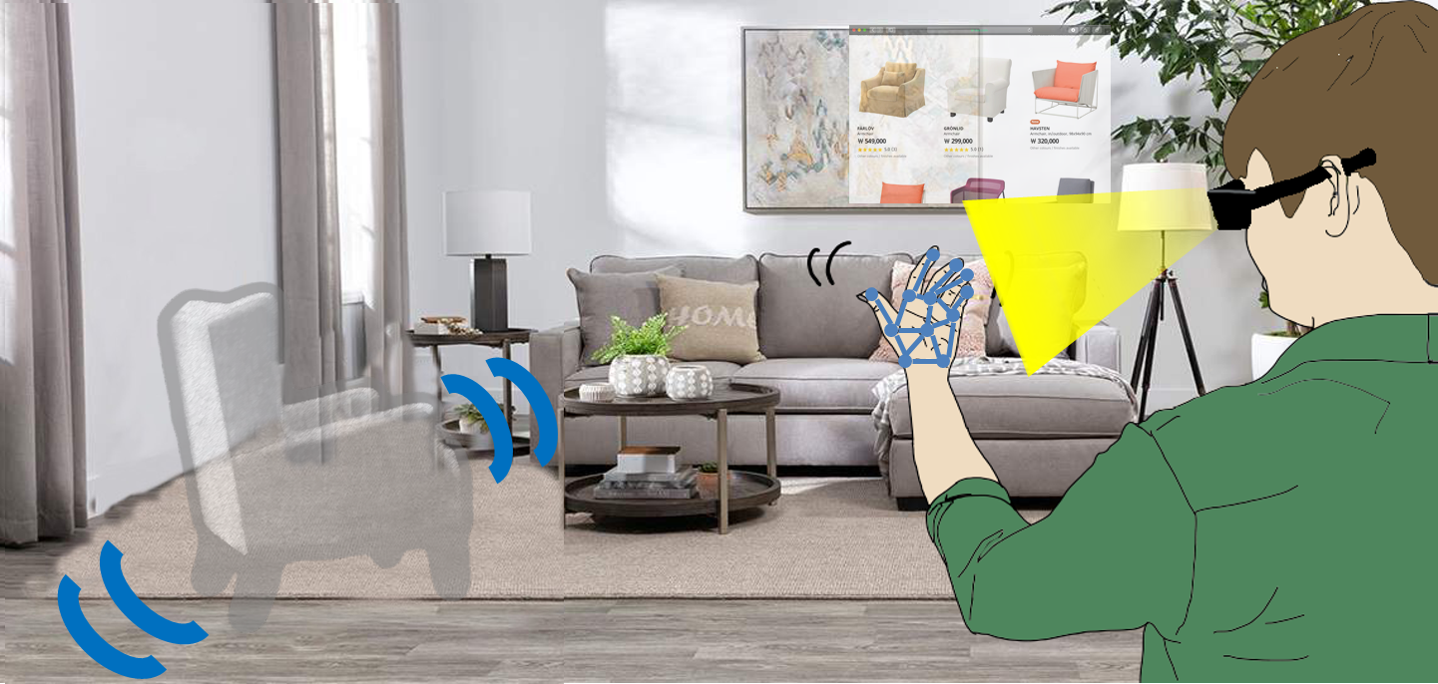
Example App: Immersive Shopping

Slide 6
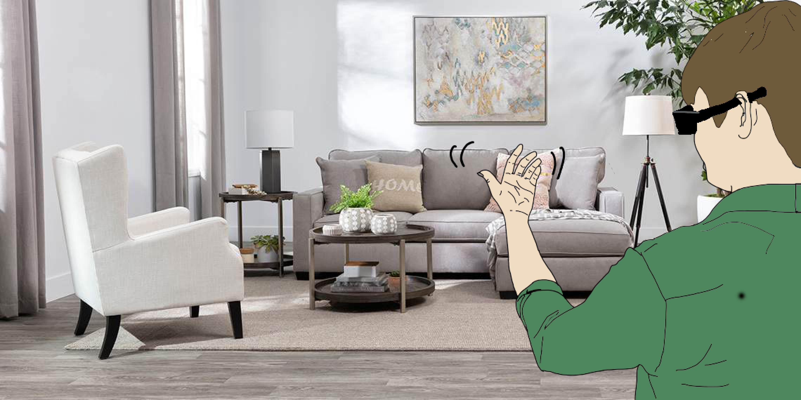
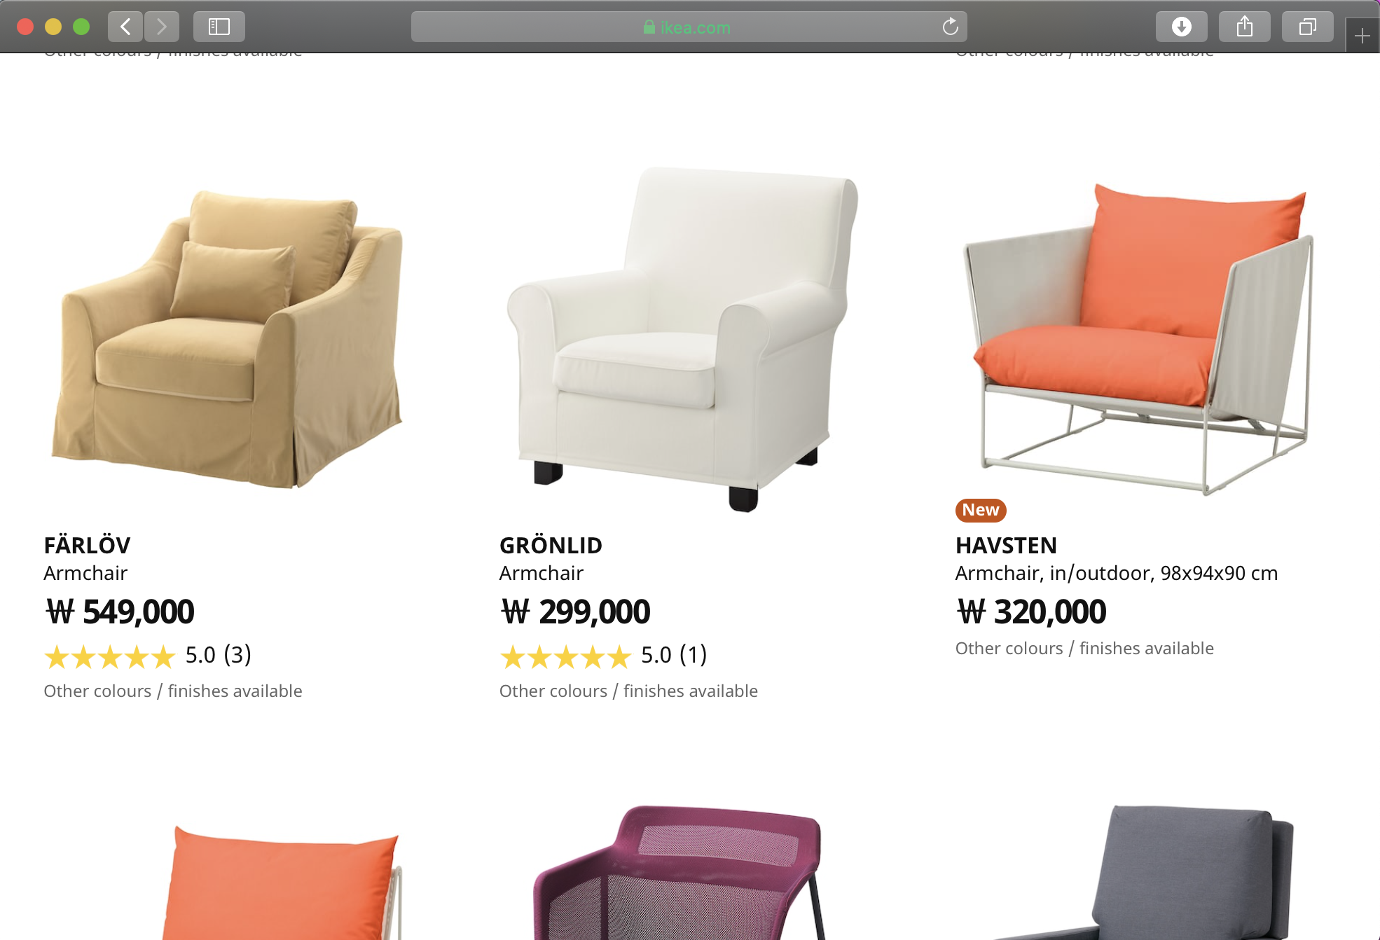
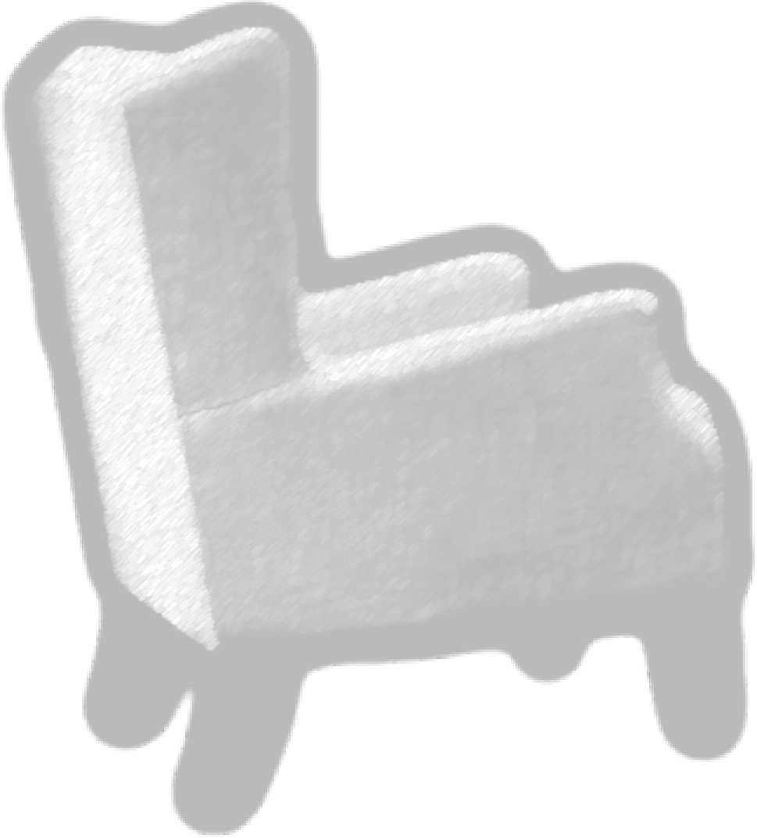
Workload Analysis
DNN
Rendering
Device
Image Style Transfer
AR Glass
Concurrent execution of multi-DNN and rendering tasks on resource-constrained mobile GPU
Object Detection & Segmentation
Virtual couch
Hand tracking

Slide 7
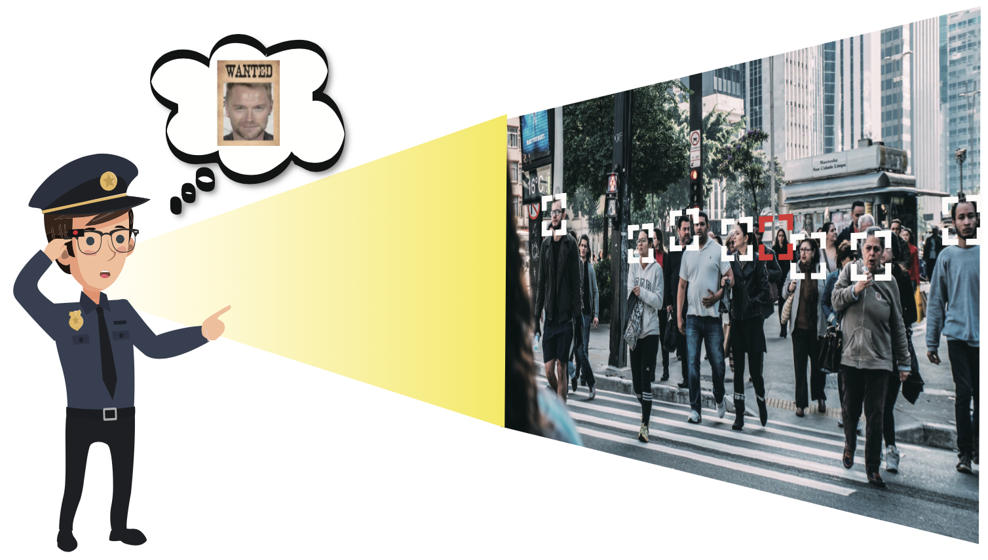
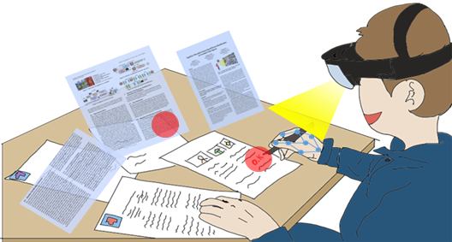
Other AR Applications
Criminal chasing
Interactive Workspace
Face detection + recognition
Virtual documents
AR Glass
AR Glass
Text detection
Hand tracking
Camera frames
DNN
Rendering
Device
Concurrent multi-DNN and rendering workload is common across future AR apps

Slide 8
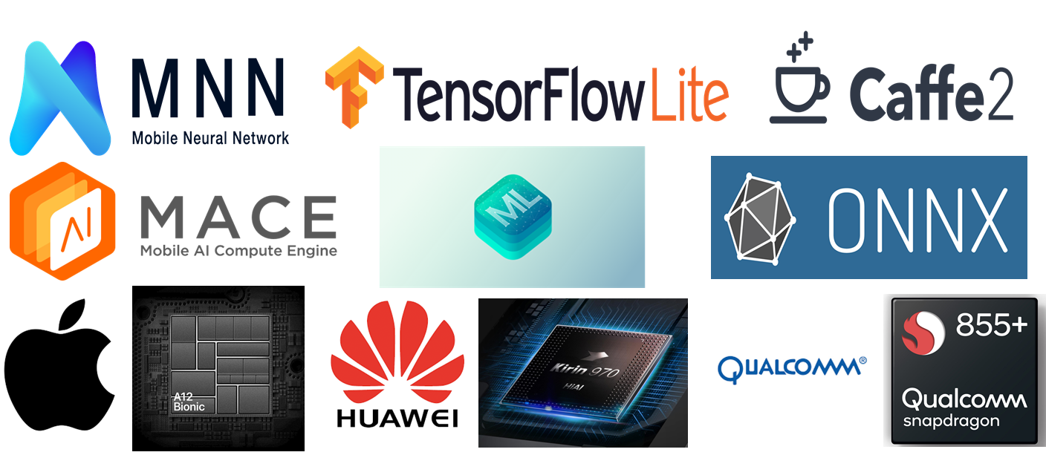
Existing Frameworks: Limitations
Designed for single DNN execution
Does not support flexible coordination with rendering

Slide 9
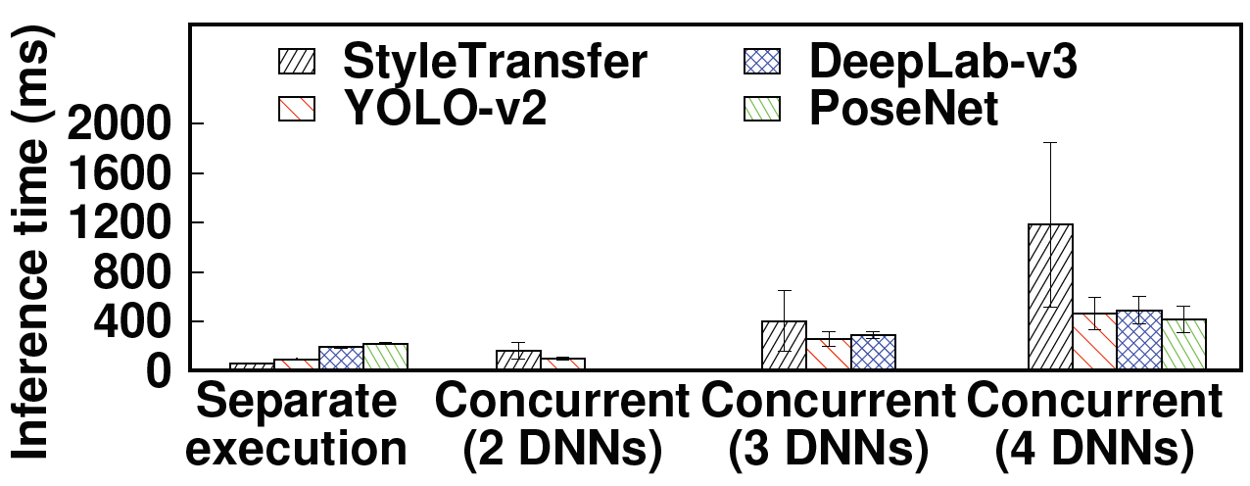
Existing Frameworks: Limitations
Measurements on Xiaomi MACE over LG V50 (Qualcomm Adreno 640 GPU)
Contention overhead
Can run at 2 fps when coordinated perfectly
Multi-DNN GPU contention degrades inference speed

Slide 10
Existing Frameworks: Limitations
Measurements on Xiaomi MACE over LG V50 (Qualcomm Adreno 640 GPU)
Average frame rate
Frame rate over time
Rendering-DNN GPU contention degrades frame rate

Slide 11
A Closer Look on GPU Contention
Problem: mobile GPU schedulers are FIFO
DNN 1
DNN 2
DNN 3
CPU 1
CPU fallback
DNN1 finished
CPU 2
DNN2 finished
CPU 3
DNN3 finished
Contention
Contention
X
X
GPU
Inference latency increases with the number of competing DNNs & CPU fallbacks

Slide 12
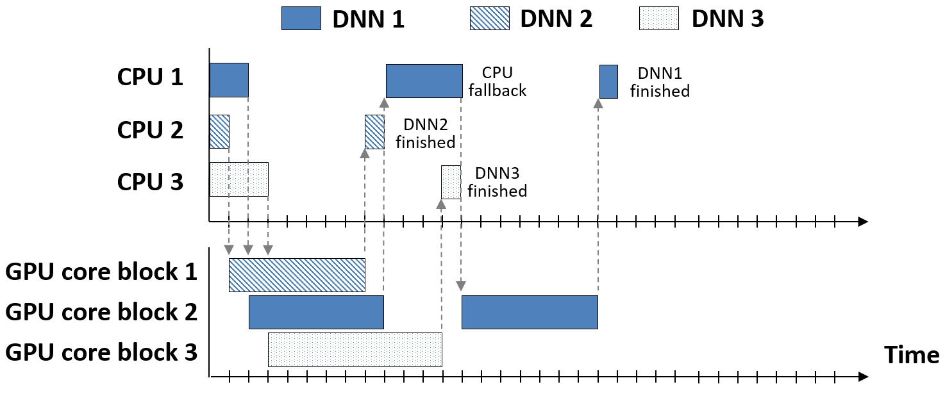
Apply Desktop GPU Scheduling?
Parallelization
No architecture support on mobile GPUs

Slide 13
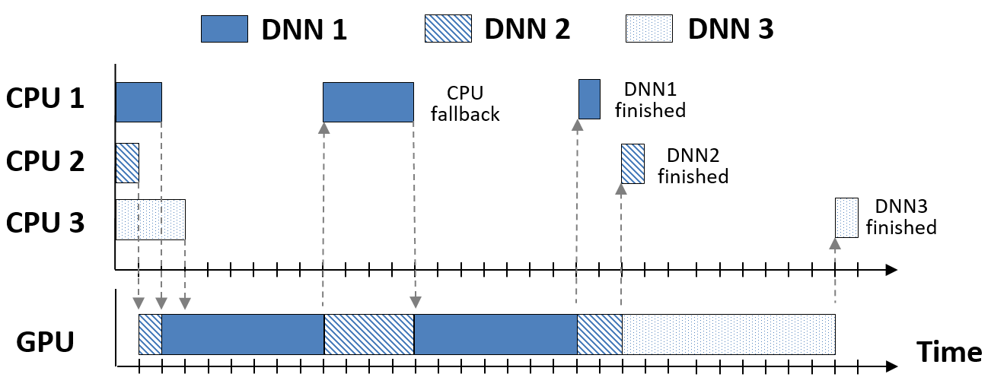
Apply Desktop GPU Scheduling?
Preemption
preempt
preempt
Challenging due to limited memory bandwidth

Slide 14
Proposed System: Heimdall
The first mobile GPU coordination platform for AR apps
Our approach: Pseudo-Preemption
When to trigger context switch?
Conventional preemption: regardless of the app context
Pseudo-Preemption: only when a semantic unit of a task is finished
→ large memory cost
→ no additional cost

Slide 15
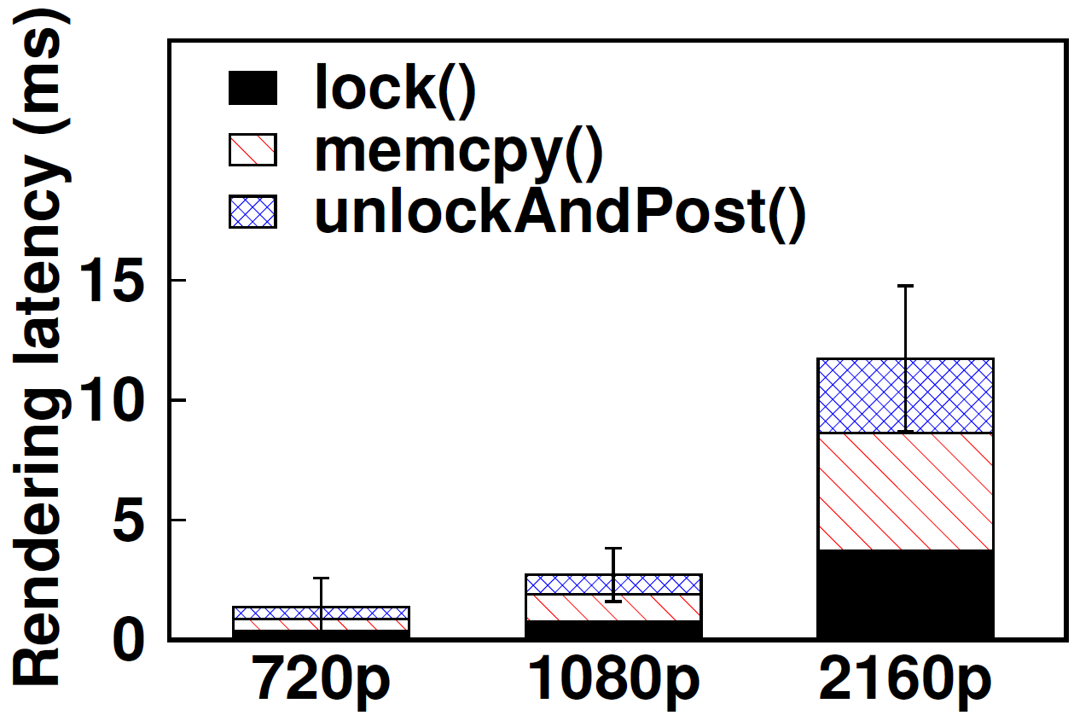
Task Partitioning: How Fine-Grained?
Rendering latencies are already small enough

Slide 16
Task Partitioning: How Fine-Grained?
Task | Model | Inference time
Object detection | YOLO-v2 | 95 ms
Face detection | RetinaFace | 230 ms
Face recognition | ArcFace | 149 ms
Image segmentation | DeepLab-v3 | 207 ms
Image style transfer | StyleTransfer | 60 ms
Hand tracking | PoseNet | 256 ms
Text detection | EAST | 214 ms
DNN inference latencies are too bulky

Slide 17
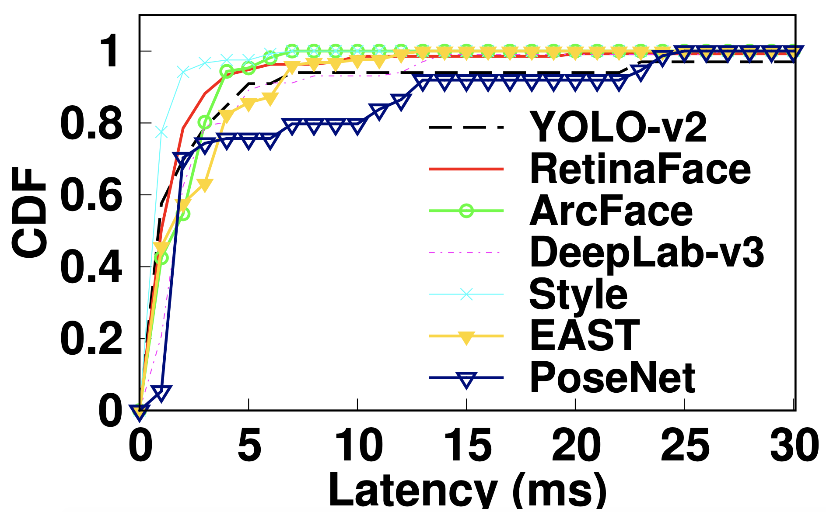
Key: Dividing the Bulky DNNs
Operator-level latency
DNN model
Conv1-1
Conv1-2
Pool1
Conv2-1
Conv2-2
Conv2-3
Pool2
Conv3-1
Conv3-2
Conv3-3
Conv3-4
Conv4-1
Conv4-2
Conv4-3
Conv4-4
FC1
DNNs can be divided into operators (89.8% runs in <5 ms)

Slide 18
Heimdall System Overview
Preemption-Enabling DNN Analyzer breaks down the DNNs into smaller units
Pseudo-Preemptive GPU Coordinator schedules concurrent GPU tasks

Slide 19
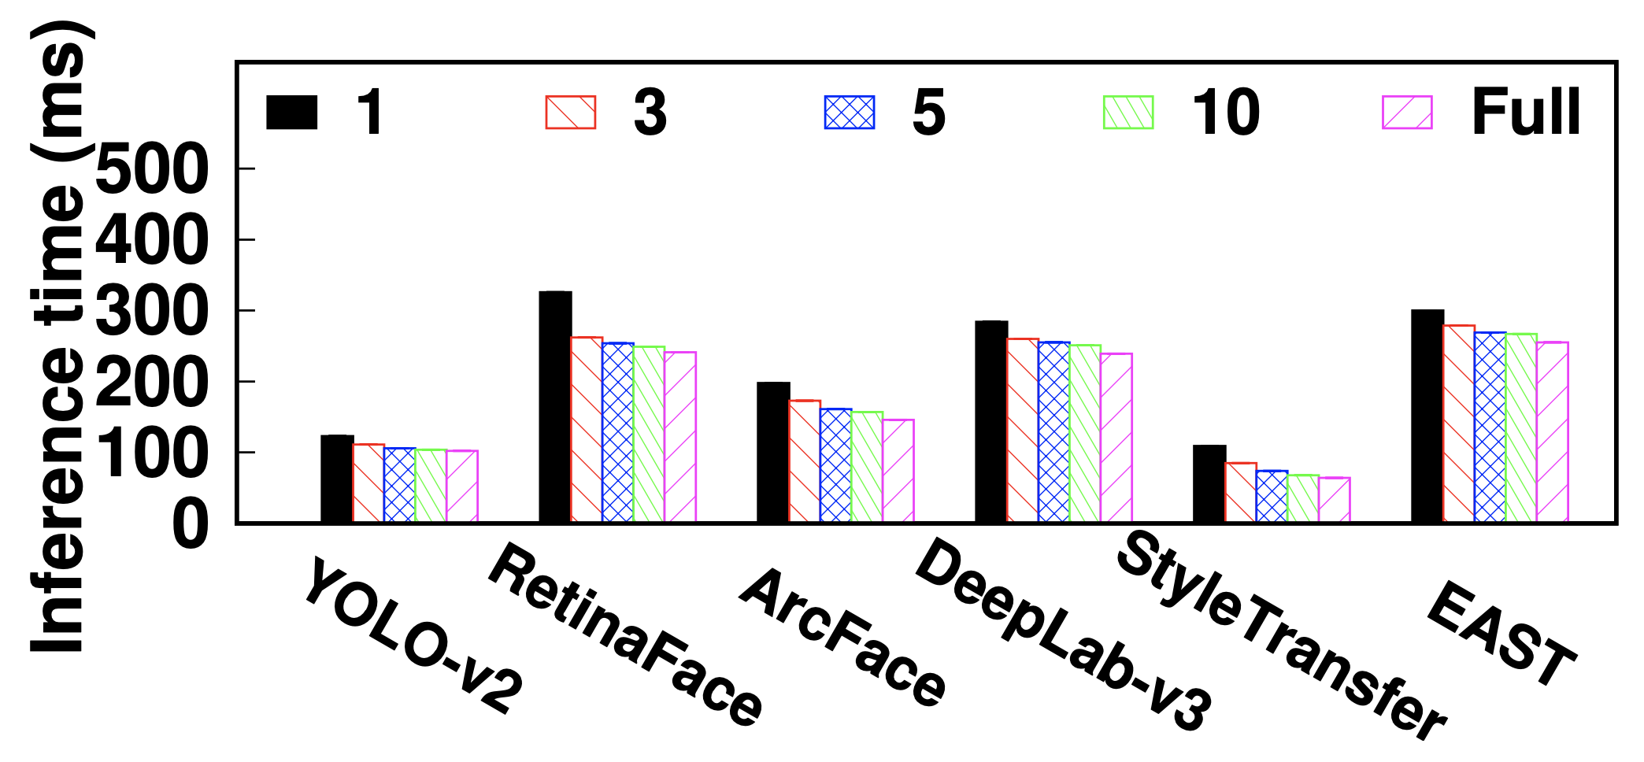
Preemption-Enabling DNN Analyzer
When to divide the DNNs?
Offline profiling suffices ($∵$ mobile GPU does not support preemption)
How to divide the DNNs?
Dividing too finely incurs inference overhead
35%
18%
18%
20%
35%
70%

Slide 20
Preemption-Enabling DNN Analyzer
When to divide the DNNs?
Offline profiling suffices ($∵$ mobile GPU does not support preemption)
How to divide the DNNs?
Dividing too finely incurs inference overhead
Pack as many operators as possible between rendering events
Available time for DNNs $T_{D}=\frac{1}{f}−T_{R}$ ms
DNN
model
Time
$$T_{D}$$
$$T_{D}$$
$$T_{D}$$
$$T_{D}$$
Rendering interval $\frac{1}{f}$ ms
Rendering latency $T_{R}$ ms
Operator index
$$p_{0}$$
$$p_{1}$$
$$p_{2}$$
$$p_{3}$$
$$p_{4}$$

Slide 21
Pseudo-Preemptive GPU Coordinator
Design philosophy
Rendering: triggered at target frame rate
DNNs: priority-based scheduling between rendering events
Rendering
DNN 1
DNN 2
DNN 3
Priority-based scheduling
Time

Slide 22
Pseudo-Preemptive GPU Coordinator
How to compare the priority of DNNs at a given time?
→ Utility function
Latency utility (freshness of current inference)
Content variation utility (scene changes from last inference)

Slide 23
Pseudo-Preemptive GPU Coordinator
Coordination policies
MaxMinUtility: fairly allocate GPU resources
MaxTotalUtility: maximize overall utility sum

Slide 24
Evaluation Setup
Device: LG V50 (Qualcomm Adreno 640 GPU)
Framework: Xiaomi MACE (OpenCL-based)
Comparison schemes
Baseline multi-threading
Model-agnostic partitioning: clEvent.wait() after every 5 clEnqueueNDRangeKernel()
Application scenario
Immersive online shopping
App requirements
Rendering | DNNs
 | StyleTransfer | YOLO-v2 (detection) | DeepLab-v3 (segmentation) | PoseNet (hand tracking)
1080p, 30 fps | < 0.1 s | 1 fps | 1 fps | 2 fps

Slide 25
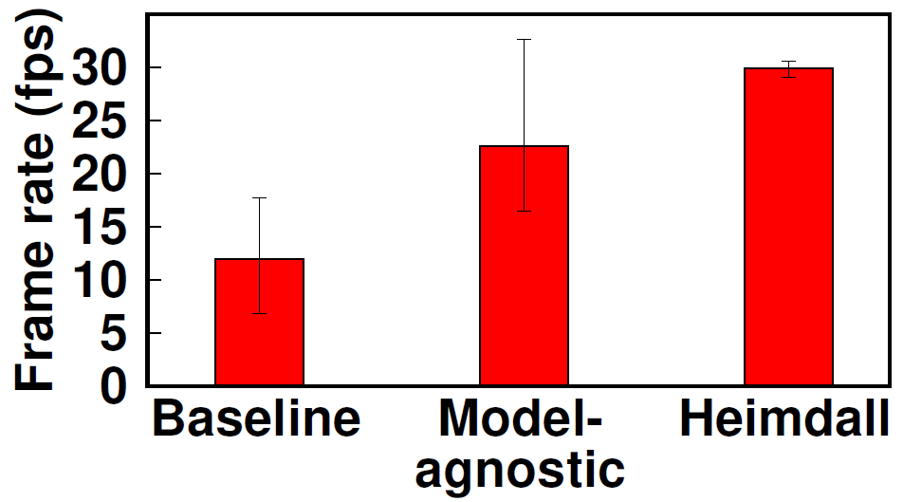
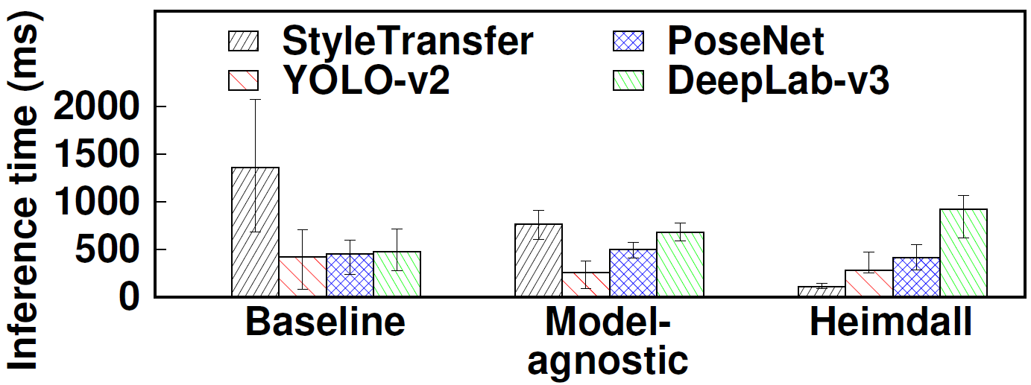
GPU Coordination Performance
DeepLab-v3
StyleTransfer
Rendering frame rate
DNN inference latency
Heimdall enhances rendering frame rate from 12 to 30 fps, reduces worst-case DNN inference latency by up to 15×

Slide 26
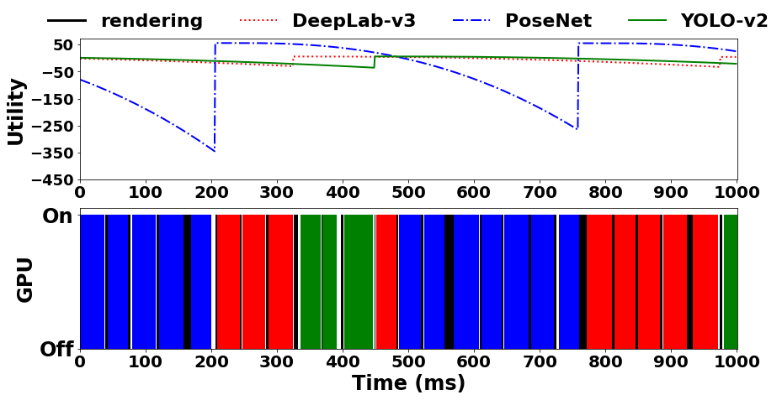
Coordination Policy Comparison
MaxMinUtility policy values fairness

Slide 27
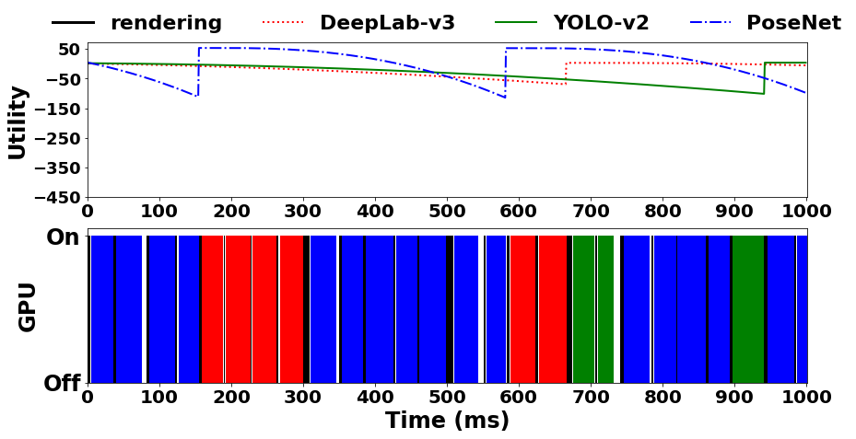
Coordination Policy Comparison
MaxTotalUtility policy values priority

Slide 28
Discussions
Is Heimdall generalizable to other mobile deep learning frameworks?
Yes, Heimdall does not require any OS or underlying system supports
Requires only marginal fixes to support partial graph inference
e.g., Google TensorFlow-Lite: Interpreter.Invoke() and Subgraph.Invoke()

Slide 29
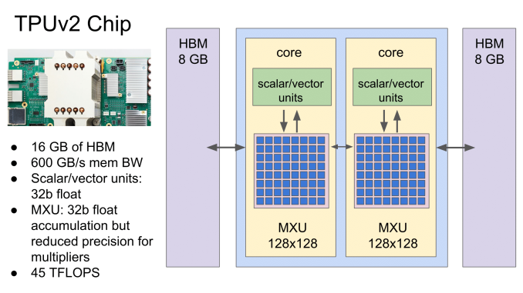
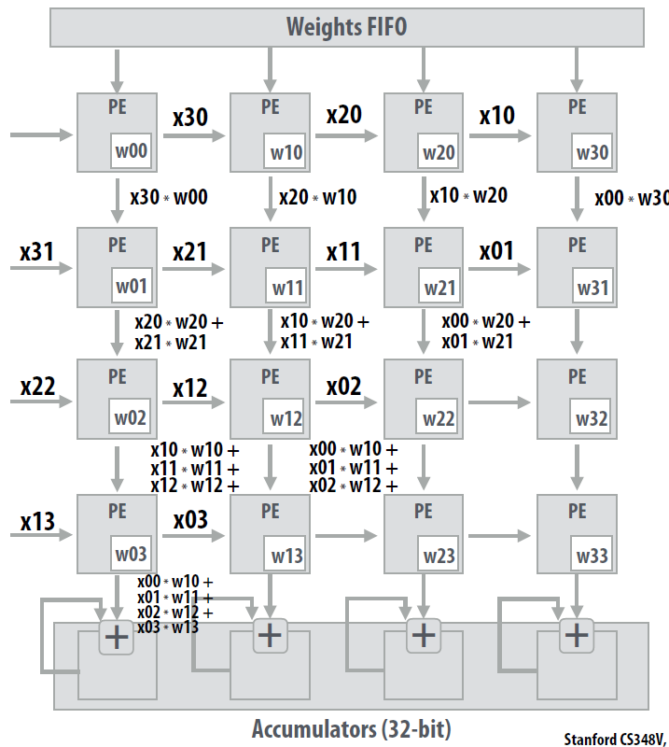
Discussions
Will Heimdall be useful for Neural Processing Units (NPUs)?
Yes, context switch is expected to be more costly
$∵$ large number of hardwired matrix multiplication units
* Figure from Stanford CS348V
* Figure from Google

Slide 30
Summary
We present Heimdall, mobile GPU coordination platform for AR applications
Pseudo-Preemption mechanism to coordinate multiple GPU tasks
Enhances frame rate from 12 to 30 fps
Reduces worst-case DNN inference latency by up to 15$×$
Heimdall is generalizable across different frameworks
For more questions, contact Juheon Yi at johnyi0606@snu.ac.kr
Juheon Yi and Youngki Lee, “Heimdall: Mobile GPU Coordination Platform for Augmented Reality Applications”

