Slide 1
EagleEye: Wearable Camera-based Person Identification in Crowded Urban Spaces
Juheon Yi¹, Sunghyun Choi², Youngki Lee¹
¹Seoul National University, ²Samsung Research Korea
ACM MobiCom 2020

Slide 2
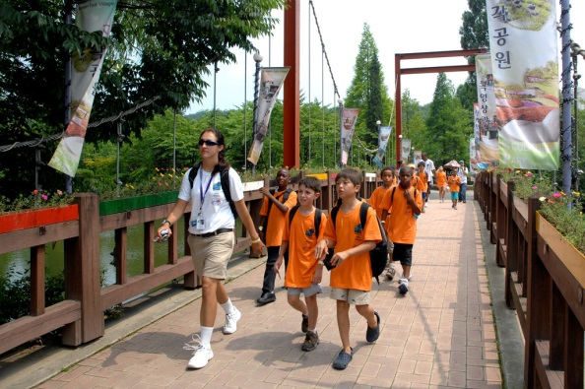
Needs for Robust Person Identification
Children counting in kindergarten field trips
Finding a crime suspect in crowded streets

Slide 3
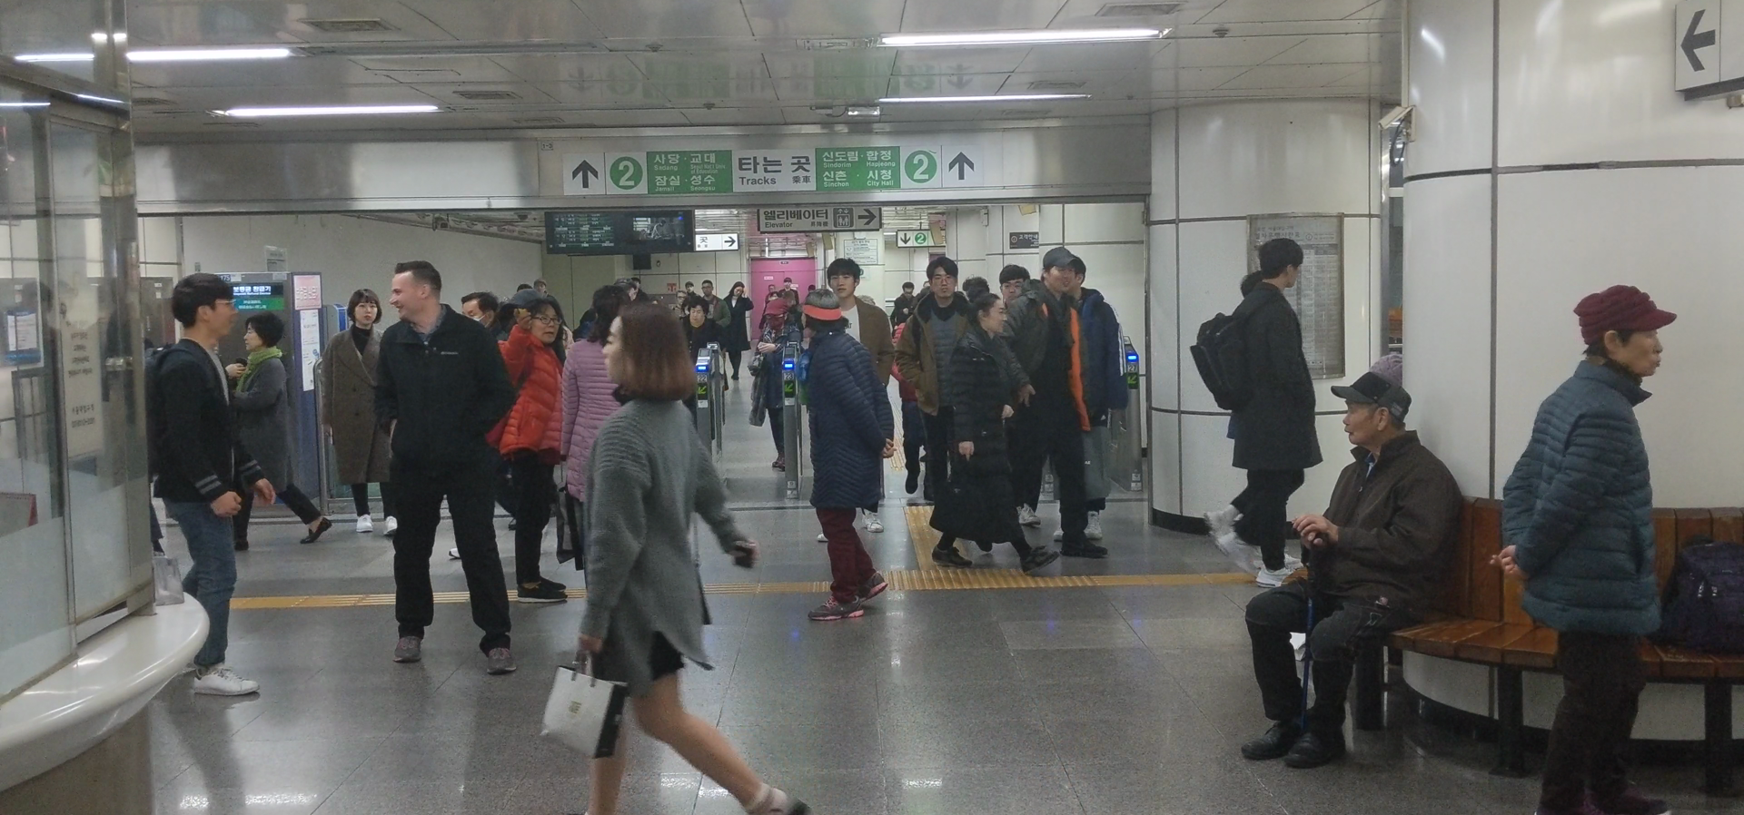
Humans: How Fast and Accurate?
In crowded scenes,
latency increases to 16 seconds, accuracy drops to 75%

Slide 4
EagleEye: AR Person Identification System

Slide 5
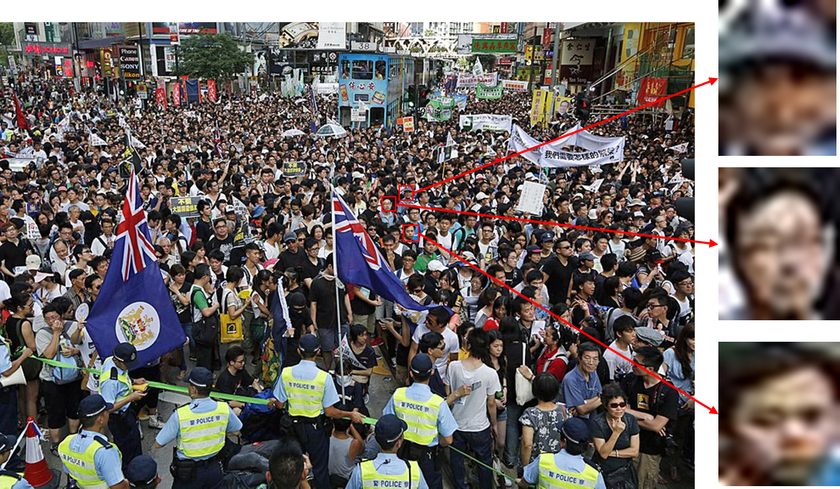
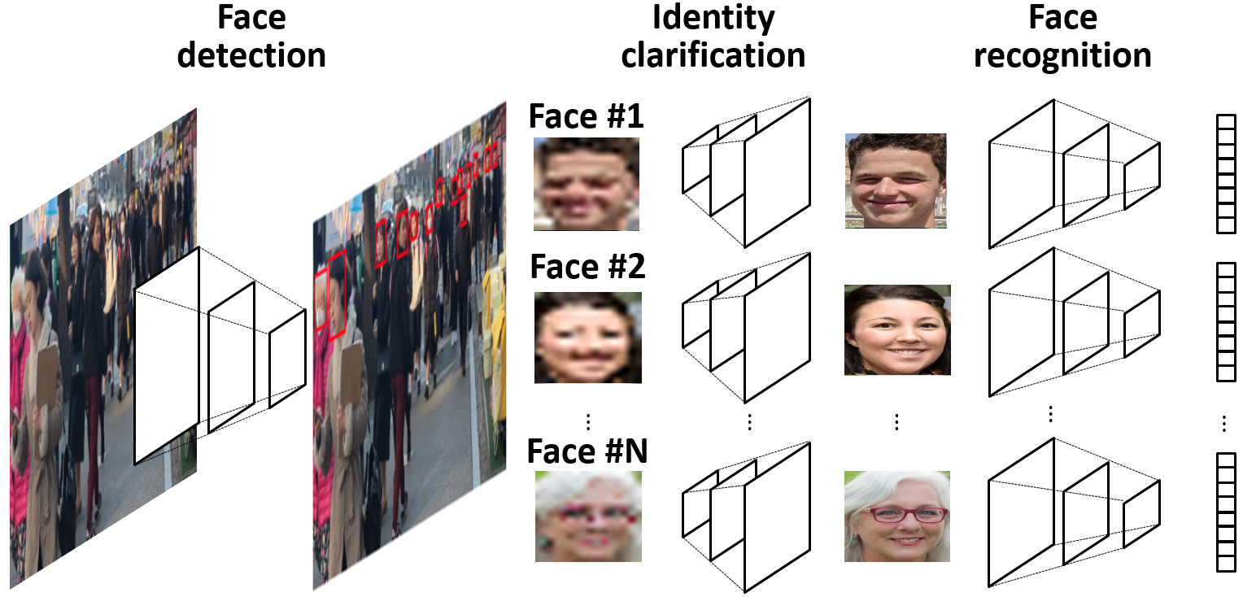
Key Challenges
How to accurately recognize small faces captured from distance?
How to run multi-DNN face identification in real-time on mobile?

Slide 6
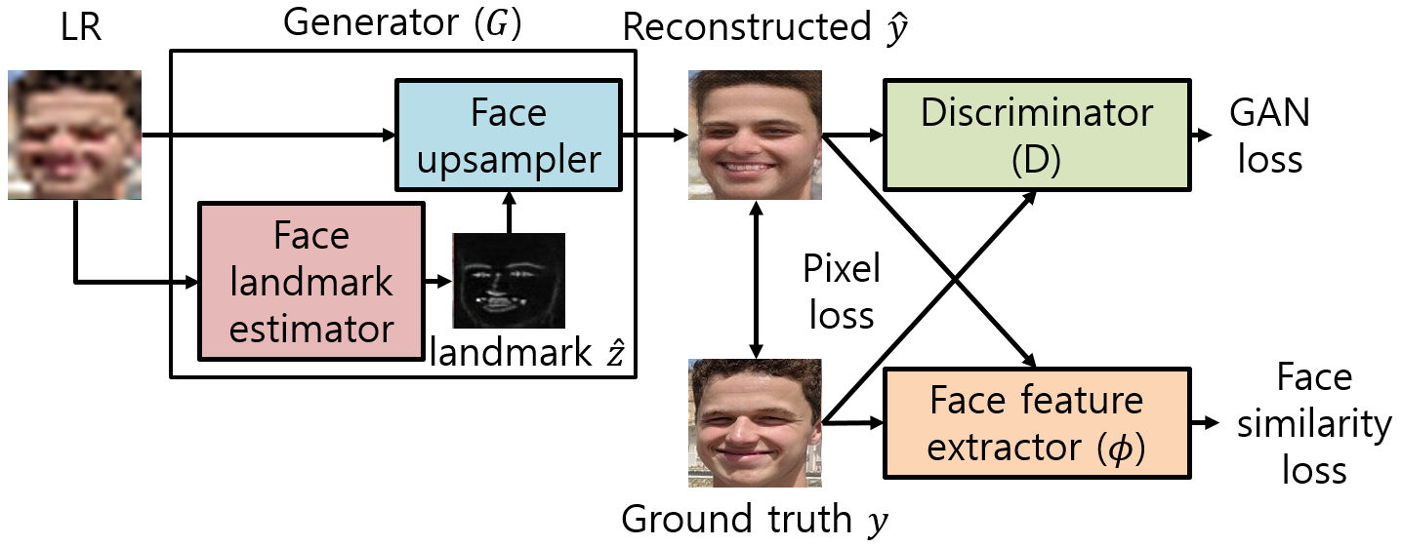
Identity Clarification Network (ICN)
Landmark-aided HR face reconstruction
Enforce reconstructed face to look realistic
Generator ($G$)
Enforce reconstructed face to preserve facial features

Slide 7
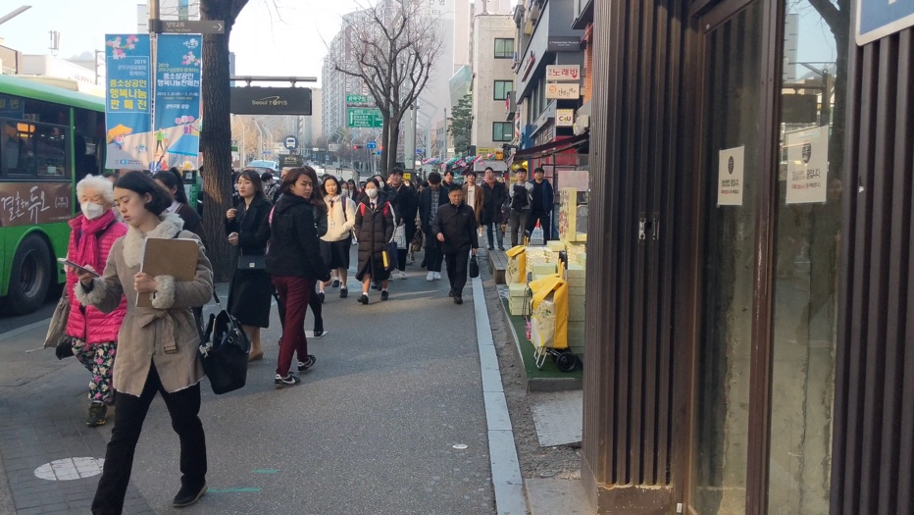
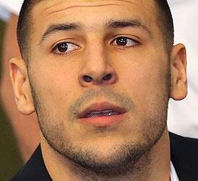
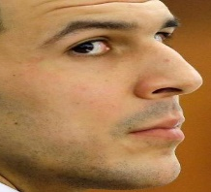
Content-Adaptive Parallel Execution
Edge-Based Background Filtering removes background regions from processing
Variation-Adaptive Face Recognition
selects pipeline based on difficulty
Spatial Pipelining processes regions in parallel over mobile and cloud

Slide 8
Key Evaluation Results
How much accuracy improvement does ICN achieve?
- ICN enhances True Positive by 78% at the cost of 14% False Positive
How much latency improvement does EagleEye achieve?
- EagleEye enhances latency by 9.07x compared to full on-device execution
How effectively does EagleEye utilize mobile and cloud resources?
- EagleEye outperforms full on-device and offloading with 108 KBytes offloaded

Slide 9
Summary
We present EagleEye, an AR-based person identification system on mobile devices
ICN enhances LR face recognition accuracy (78% gain in TP at the cost of 14% FP)
Content-Adaptive Parallel Execution enhances face identification latency by 9.07x
For more questions, contact Juheon Yi at johnyi0606@snu.ac.kr
Juheon Yi, Sunghyun Choi, and Youngki Lee, “EagleEye: Wearable camera-based person identification in crowded urban spaces”

